Slide 1
Portfolio Analysis of 10 Selected Assets
Group Number: G14
Kakarla Sai Swaroop(G24AI1026)
Purushothaman S(G24AI1042)
Mugundan B(G24AI1051)
Sri Charan Reddy(G24AI1095)
Aakansha Nalamati(G24AI1111)
Pranav Srivatsav Tenali Gnana(G24AI1114)

Slide 2
Outline
Analyze historical performance of 10 selected assets
Compute descriptive statistics, correlations
Construct a combined index
Develop Markowitz Efficient Frontier, CML, SML
Estimate risk and return metrics

Slide 3
Selected Assets
1
AAPL (Apple)
2
MSFT (Microsoft)
8
BND (Bond ETF)
3
TSLA (Tesla)
9
GLD (Gold ETF)
4
AMZN (Amazon)
10
BTC-USD (Bitcoin)t
5
GOOG (Google)
6
NVDA (NVIDIA)
7
JNJ (Johnson & Johnson)

Slide 4
Data Collection
import yfinance as yf
import pandas as pd
data = yf.download(tickers=list(stocks), start='2021-06-26', end='2024-06-26',auto_adjust=False)['Adj Close']
data.to_csv("closing_prices.csv")

Slide 5
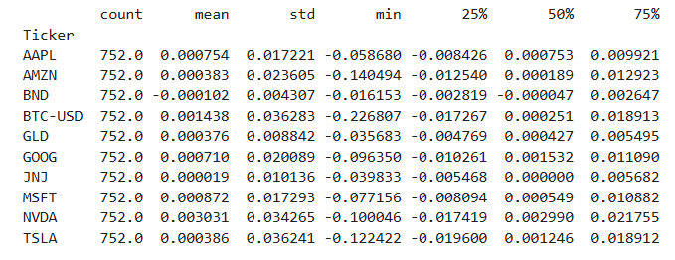
Descriptive Statistics

Slide 6
Time Series & Histograms
1

Slide 7
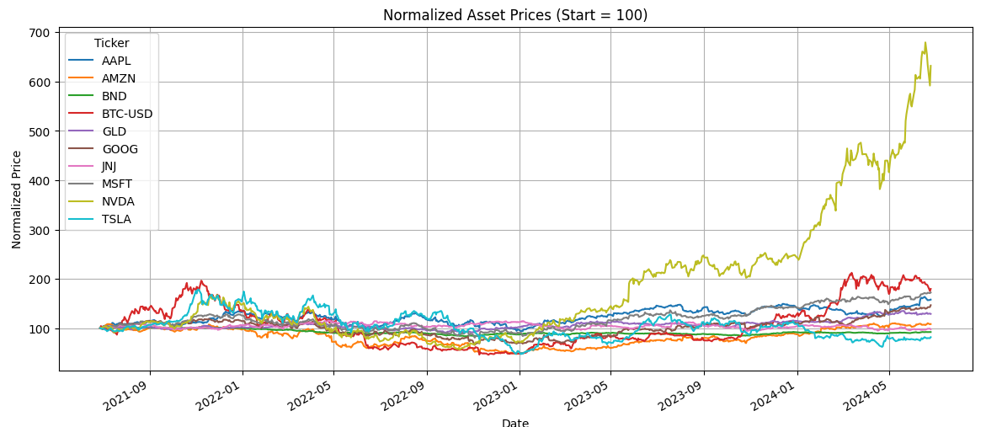
Use cases / user stories

Slide 8
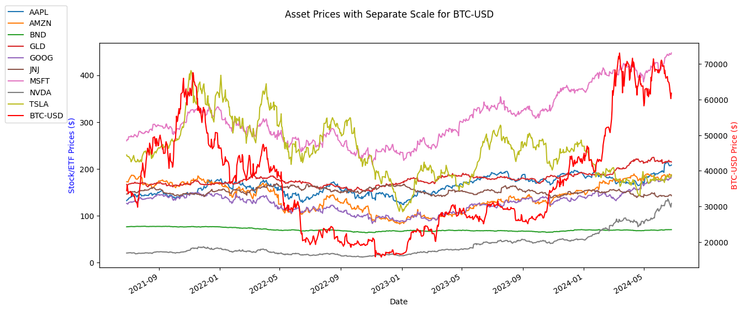
Use cases / user stories

Slide 9
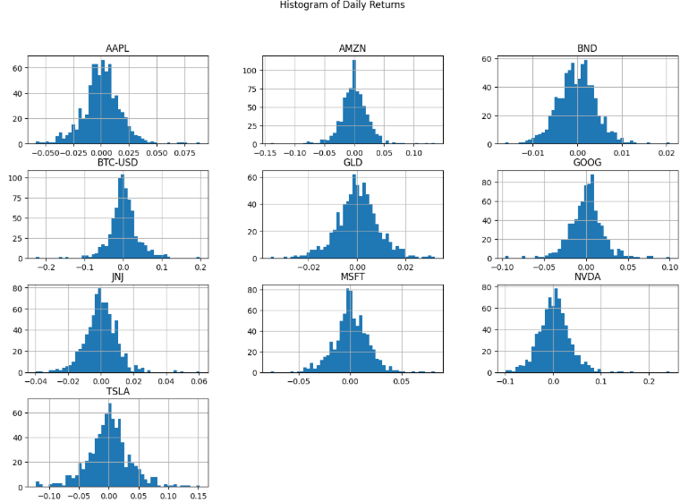

Slide 10
Correlation Analysis

Slide 11
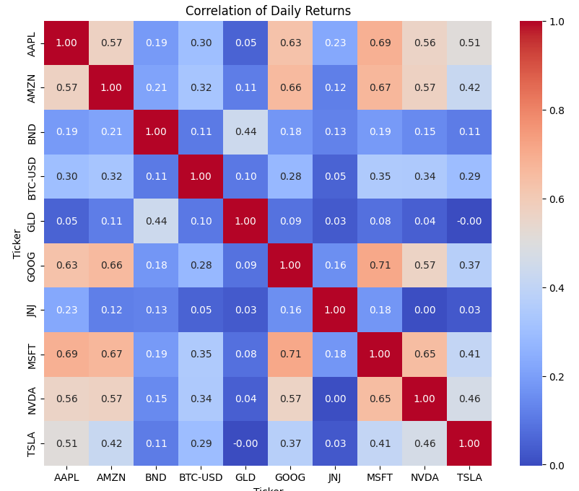

Slide 12
Combined Index

Slide 13
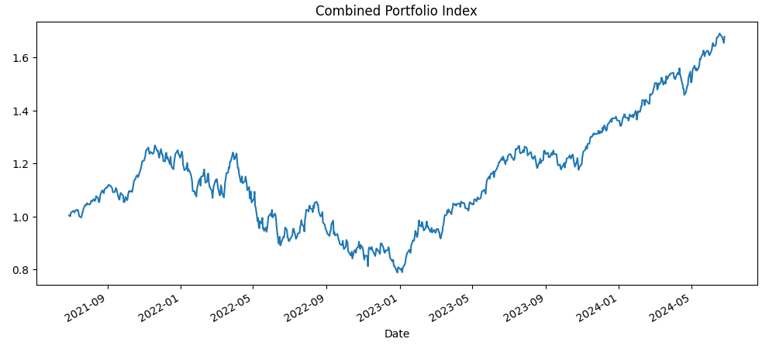

Slide 14
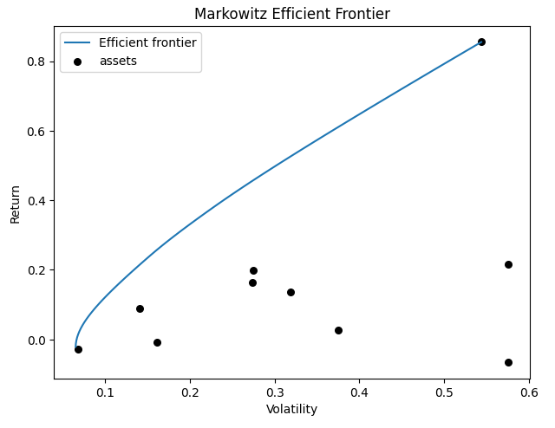
Markowitz Efficient Frontier

Slide 15
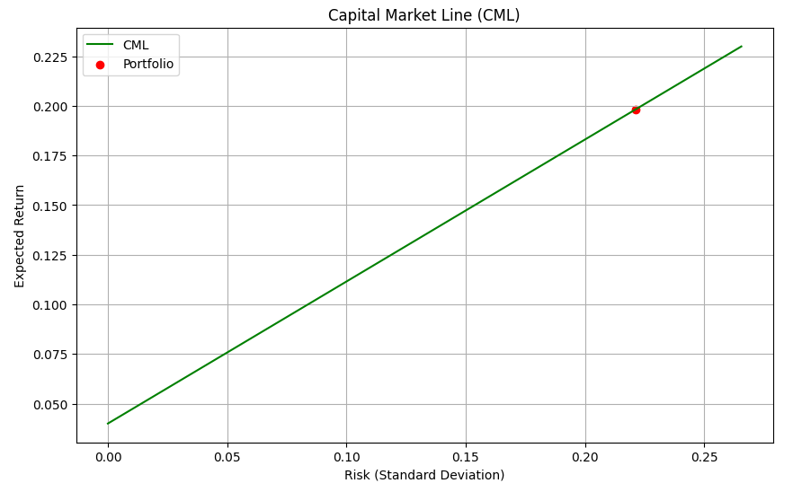
Capital Market Line(CML)

Slide 16
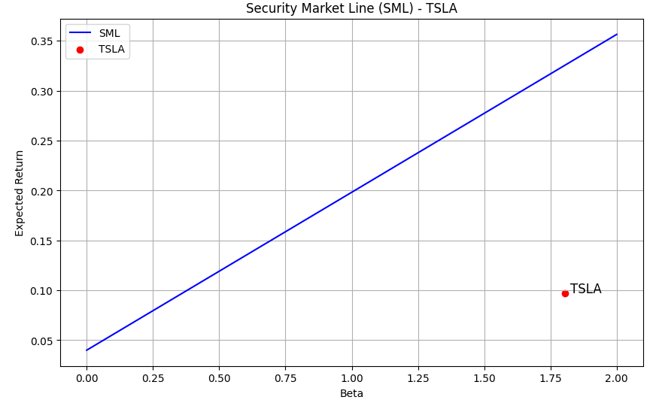
Security Market Line(SML)

Slide 17
Conclusion & Key Insights
Combined portfolio demonstrates diversified risk-return profile
Tech stocks showed strong internal correlation; crypto diverged
Efficient Frontier visualized optimal trade-off between risk and return
CML indicated potential Sharpe-efficient allocation
SML helped assess asset valuation using beta and CAPM
Highlights the importance of diversified, data-driven investing

Slide 18
Thank You

